Slide 1
Page rank algorithm with MPI
Project report slides

Slide 2
Included files
pageRankMpi.c: contains the source code of the page rage algorithm adapted to parallel computing. Takes as input a matrix in csv format and outputs the result vector in csv.
Csvparser.c, csvwriter.c: libraries (found on sourceforge) for reading and writing csv files
Example_matrix.csv /.xlsx: Represents the input matrix mapping the linking structure if www.financeutile.com. Generated using python code (not included) with the scrapy library to crawl the website and parse the pages.
Functions1d.c: contains auxiliary functions, mainly for matrix calculations (generating matrices, calculating norms, matrix addition/multiplication, copying matrices…)
Pagerank.csv: the results generated by the algorithm for www.financeutile.com (i.e. using example_test_matrix.csv as input)

Slide 3

The equation to solve for pagerank
R: page rank vector
M: Modified adjacency matrix (see calculation in report)
d: damping factor
N: total number of pages
E: matrix of ones

Slide 4
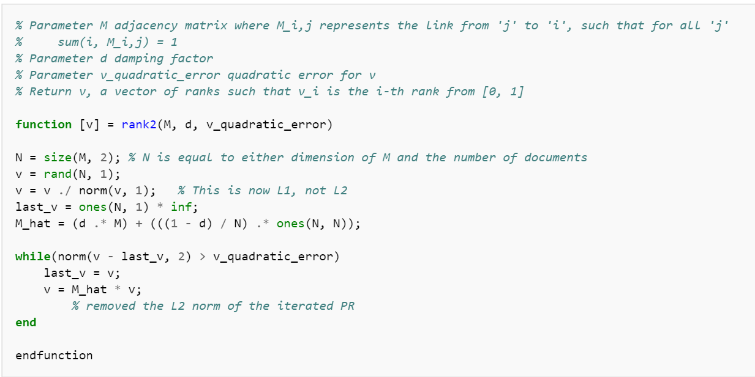
Sequential algorithm
The page rank equations gives a principal eigenvector problem to solve.
The power iteration method is used.
Parallel computation is used for the matrix vector product operation
Source: https://en.wikipedia.org/wiki/PageRank

Slide 5
Parallel algorithm principle for matrix vector product
A master/slave process structure is used to distribute the work
The master initialises the problem, divides the global matrix in to row bands, distributes these row bands to the slave processers, and then reassembles the local results into a global result when the local calculations are finished
The slave processers receive a row band matrix and a vector from the master and sequential perform the product before sending result back to master.
This master/slave structure is encapsulated in a while loop, and the product is executed until convergence (small error between vi and vi-1

Slide 6
Application to www.financeutile.com
Adjacency matrix and page rank can be found in example_matrix.xlsx and pagerank.csv
The algorithm can take matrixes entered in csv form and output the page rank to csv

Slide 7
See report.docx for more information

